Slide 1
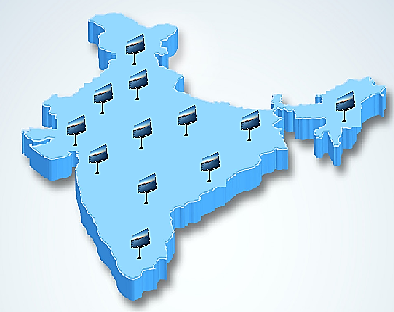
National LED Screens network on 550+ Toll Plazas

Slide 2
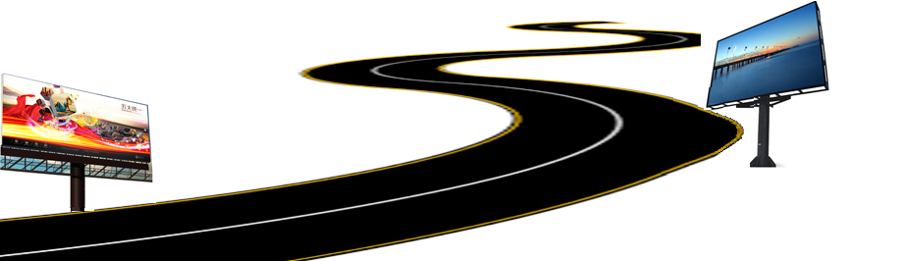
Executive Summary
The objective of this presentation is to propose building a national infrastructure of mass communication, provisioned via network of LED-wall based point of displays (POD), installed across pan-India roadway toll station.
Through the course of this presentation, we aspire to demonstrate how the best in class & multi-purpose visual media displays would provide a variety of flexible benefits to NHAI and our project detail for successful execution.
We are experienced in pan-India communication programs with proficiency in brand planning, creative development, media & even planning and digital integration.
Through the course of this presentation, we aspire to demonstrate how the best in

Slide 3

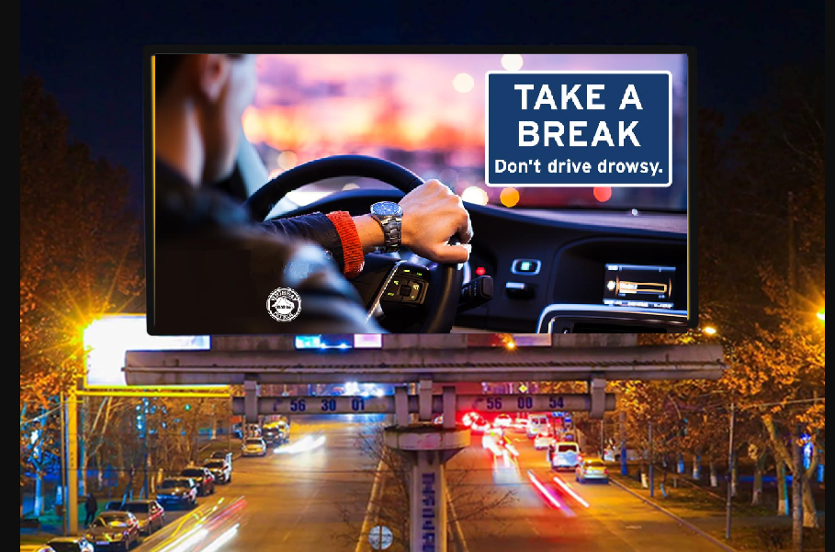
Body of Work
Installation of 18x12ft LED Point of Displays (POD) at Toll stations on national roads, including expressways, national & state highways and intra-city roadways.
All existing 550+ Toll stations to be equipped with the PODs, with additional flexibility to promptly install screens on new/under-development toll stations.
This concept is seamlessly extensible to urban corporate & commercial promotion infrastructure setup & management too.
POD will be designed to play video streams, motion pictures, still images & scrolling text and will be installed on top of 18-20 feet high platform, for clear visibility upto 150 meters.
All PODs will be centrally managed from a control room, with recovery systems for business continuity during any unplanned outages.

Slide 4
Details of Hardware
Bigger column diameter - 200 mm, Smaller column diameter - 150 mm
Both columns will be connected by flanges
Final column will be mounted on concrete base by anchor bolts
Column will be supported by two C-channel from opposite sides to cater for wind load
C- channel frame will be mounted on top of column to support digital board
3 column supports are required for 12ft x 18ft advertising board
Oil & Radium painted surface finish (All seasons + night vision + lifespan 10 years)
Artefact | Period
Fabrication | 2 Days
Installation | 1 Day
Foundation | 4 Days
Phase 1 implementation (150 locations) | < 100 Days

Slide 5
Installation of Hardware and Software
LED Grid display will be integrated with a controller which will be attached to a processor which will run the software for the content of desired choice.
Processor will have a internet connectivity which will upload the content to the desired location, content will be software driven.
Software will have the ability to change the content from the control room. It will have flexibility to dynamically display the content automatically, during required timings.
Content will be designed in such a way that the commuter will be able to view it from a distance of about 150 meters.
Power backup can be provided by diesel generator & surpassed with UPS of correct wattage.
Bespoke software to run on all stand alone systems powered through a powerful quad core processor to play media.
Software WILL be remotely operated on for individual machines or mobile applications and will be broadcasted to all PODs across India through internet connectivity.

Slide 6
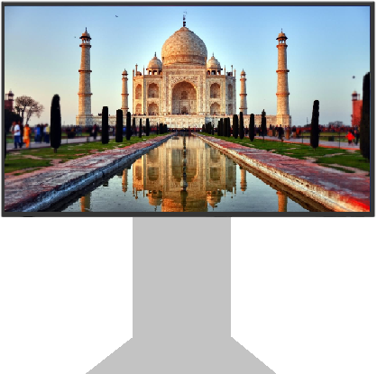


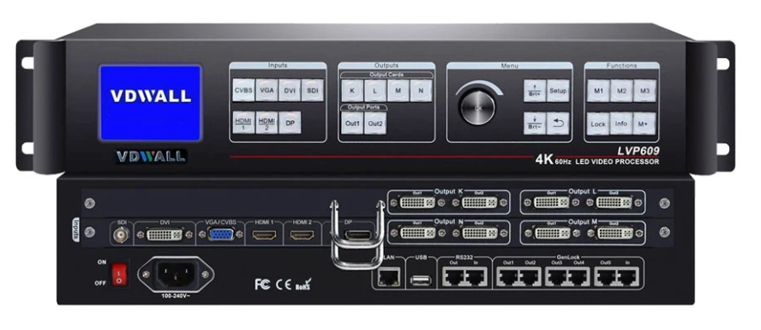
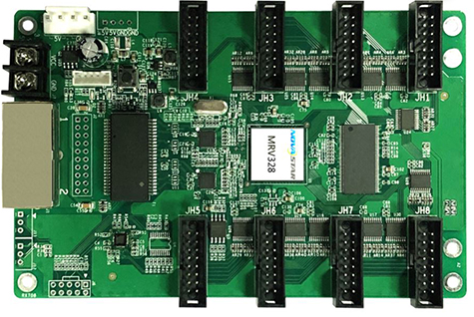
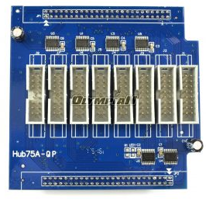
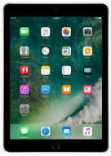
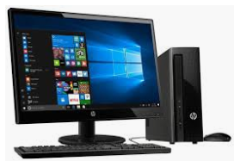
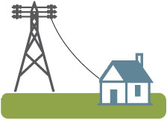
End to End Infrastructure
POD
Video Processor &
Application Software
Receiving
Card
Sending
Card
Control System
Power Distribution

Slide 7





Value Proposition
Mass communication
Instrument, with daily reach to over 10 crore travelers
Broadcast in local language, allowing communication to reach wide range of audience
Emergency communications
can be displayed for public awareness in extreme incidents like natural disaster, fire, accidents etc.
Location specific broadcast
allowing most relevant communication to reach local residents
10% time allotment to NHAI of the transmission time for dedicated road safety & traffic management
Immediate broadcast
of message across media channels like video, image, text etc.

Slide 8
Value added features
The idea behind the installation of the large screen at at every toll plaza will to be to create a visual awareness for the commuter in different facets of life and allow us many opportunities as:
Sponsored advertisements
Government advertisements & campaigns
Dedicated support to NHAI communications
Safety standards & alerts
Traffic & congestion updates
Public messages & crisis communications
Various aspects of road safety & precautions
Health tips & watch items
Expedited information sharing & disaster communications e.g. floods, road closures etc.
Utilities & service stops with facilities, exit points
Software will be bespoke and smartly designed to centrally manage media content to be broadcasted on pan-India screens & monitored from same central hub
All changes will be centrally managed & communicated remotely via the hub

Slide 9
LED Tech Specs:
S. NO. | Artefact | Description | Configuration
1 | Model | FS 10/12 | 10-12mm Pixel Pitch
2 | Physical Density | 10-12k dot/m2
3 | LED Config | 1R1G1B | SMD3535
4 | Module Size | 320x160 | 32x16 pixels
5 | Drive Mode | 1/4 Constant Current Drive
6 | Viewing Angle (Deg) | H140/V140 | Brightness 5500
7 | Grey Scale | 16 bits | Refresh rate 1920
8 | Cabinet Resolution | 96x96 Pixels | Weight 50 KG
9 | Power Consumption (W/m2) | Max: 750 / AvG : 250
10 | Cabinet Material | Iron / Aluminium | Color >16.7
11 | Input Voltage | 110-220V AC (+/- 10%) | IP65 Protection
12 | Refresh Frequency | 60HZ
13 | Humidity Support | 10-95% | Temp: -30 to +60
14 | Certificates | CCC, CE, R0HS

Slide 10
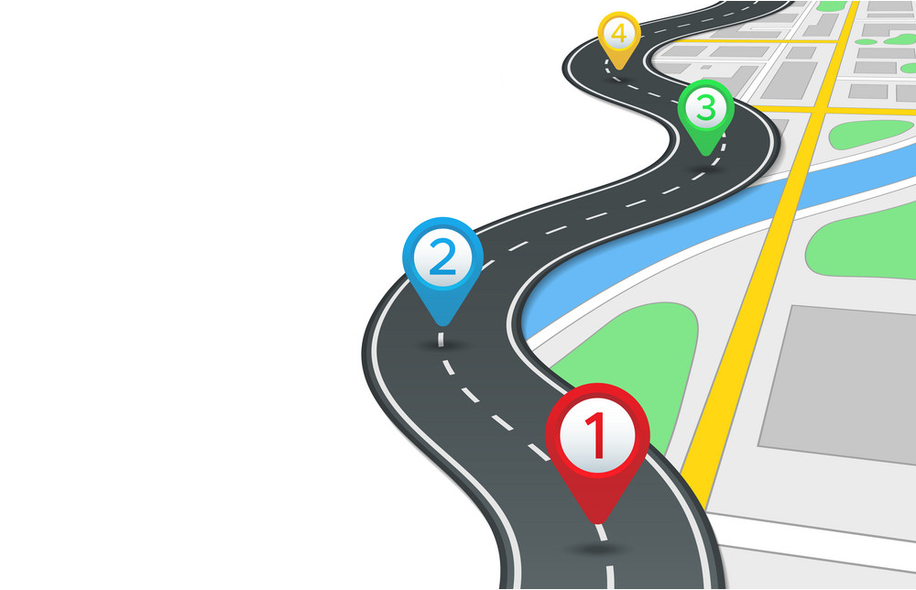
Project Plan & Duration
4
Phase 3: 12 months
POD installation on final 200 locations
Beta Testing & Handover – Q2 2025
AMC commencement
3
Phase 2: 12 months
POD installation at 150 locations
Beta Testing – Q1 2024
2
Phase 1: 12 months
POD installation at 150 locations
Beta Testing – Q1 2023
1
Project Approval and Commencement
Q1 2022

Slide 11
Project Phase Financials
2024
Return Of Investment 2024-25
AMC for the entire project will be 25% of the total project cost & will remain with founding company post lease completion

Slide 12
NHAI Support
To accelerate implementation of this program, a support model is also requested NHAI, as:
POD installation space at all national Toll Plazas
POD installation space next to Toll Ahead sign boards
Space on over-bridges, for possible future extension of PODs
20KVA electricity supply line (to be paid for & maintained by project team)
POD & electricity line access to AMC contract vendor for maintenance purposes
Lease term of 9 years

Slide 13
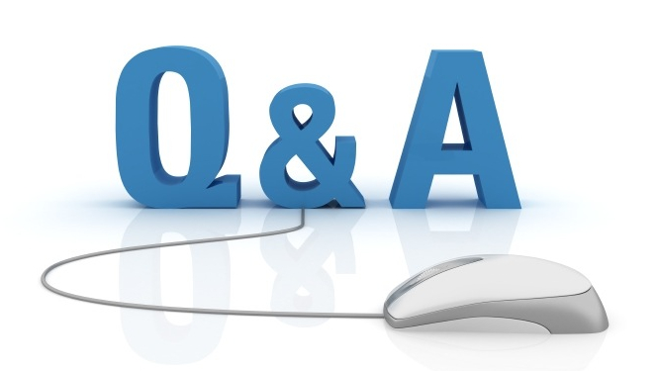
Q & A

